Slide 1
CHAPTER-1
Semiconductors
Insulators
Conductors
CLASSIFICATION OF MATERIALS

Slide 2
TOPICS TO BE COVERED
Classification -conducting, semi conducting and insulating materials
Energy bands

Slide 3
INTRODUCTION
EEEM -core engineering subject
Various types of materials are required for manufacturing-so perfect knowledge of materials is must
Every material has different properties and specific function
For the Selection of suitable engineering materials , we should know physical, chemical, mechanical and electrical properties

Slide 4
Classification of EEEM
The electrical and electronics material can be classified into following types:
• Conducting materials
• Semi conducting materials
• Insulating materials
• Magnetic materials

Slide 5
Engineering Materials
Conducting Matierials
Insulating Matierials
Semiconducting Matierials
Magnetic
Matierials
Gold , silver, copper, Al, Pt,Brass, Bronze etc (Resistivity very low )
Rubber, mica, wood, glass, ceramic (Resistivity very high )
Silicon, Ge, gallium, Arsenide etc
(Resistivity -Medium )
Iron, nickel, tungsten, steel etc

Slide 6
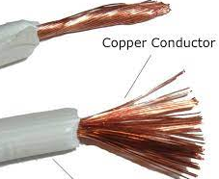
Conducting material
In which electric current can easily flow
In other word, materials which offer very low resistance to electric current
The resistivity of these materials is very low, its values lies between 10^-8 -10^-6 Ω-m.
• Example -copper, aluminum, brass bronze etc.

Slide 7
Insulating material
Do not allow the passage of electric current
Offers very high resistance to electric current
The resistivity of these materials is very high,
its values lies between 10^12 -10^18 Ω-m.
Example :Rubber, wood, glass ceramic, mica etc
Most insulators are compounds of several elements.
Dielectric materials-which can store electrical energy. Ex-air, mica, ceramic

Slide 8
Semi-conducting material
Conductivity of these material is less than conductor but more than insulator.
Material whose resistivity is less than insulator but more than conductor.
The resistivity of these materials is medium
Its values lies between 10^0-10^2Ω-m.
Example:- silicon, germanium, gallium etc.
Used in manufacturing of semiconductor devices-diodes, transistors etc

Slide 9
Magnetic material
The magnetic material are those materials which can be magnetized and which are attracted towards the magnet.
Such material create a magnetic field on the surrounding space
Example : Iron, nickel and cobalt

Slide 10
Introduction to Atomic theory
Matter-Solid, Liquid & Gases
Matter consists of minute particles called molecules which can be further divided into atoms

Slide 11
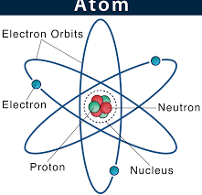
Atom
Tiny discrete particle which is incapable of division.
It’s a greek word-”which can’t be sub divided.

Slide 12
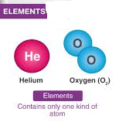
Elements
Substances whose molecules consists of similar atoms
No. of stable elements are so far 105.

Slide 13
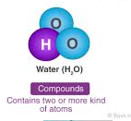
Compounds
Materials whose molecules consists of dissimilar atoms
No of compounds are unlimited

Slide 14
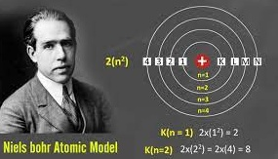
Atomic Theories
Thomson’s Theory
Rutherford’s Theory
Bohr’s Theory (mainly this is considered)

Slide 15
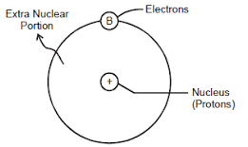
Bohr’s theory
Atom of an element consists of two main parts-
Nucleus
Extra- Nucleus

Slide 16
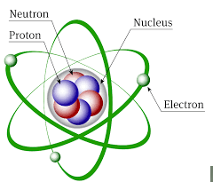
NUCLEUS
Central part of an atom
Protons + Neutrons
Holds the entire mass of an atom
Protons → +vely charged
Neutrons → no charge
Net charge on nucleus → +ve charge
No of protons =atomic number of an element

Slide 17
EXTRA-NUCLEUS
Outermost part of an atom around the nucleus
Contains electrons only
No. of electrons = No. of protons
An atom is electrically neutral
No. of elecons in any orbit = 2n^2
n= number of orbit from the nucleus
Electrons on various energy levels are arranged in definite shells namely K, L, M , N
Outermost orbit can contain maximum 8 electrons

Slide 19
Classification of Materials ( on the basis of Atomic theory)
1. Conducting materials
2. Semi-conducting materials
3. Insulating materials
NOTE:- No. of electrons in the valence orbit will decide its conductivity

Slide 20
Conducting materials
On the basis of atomic structure, those materials whose outermost orbit is incomplete
When an atom receives small energy in the form of heat or electrical charge , the valence electrons leaves their parent atoms to become free
Free electrons can freely move constituting current to flow
Such elements are good conductors of electricity
Ex- Copper, Aluminum, magnesium , , phosphorus etc

Slide 21
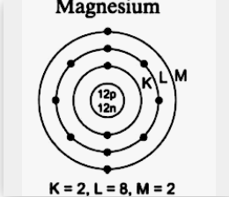

Slide 22
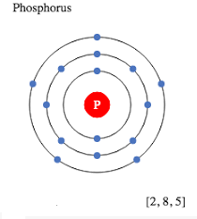
Atomic structure of conductors

Slide 23
Semi-conducting materials
Elements have 4 valence electrons in the valence orbit
These materials behave as insulators at absolute zero degree temperature
Partial flow of electrons takes place i.e some electrons becomes free, but some electrons are not free
Properties of semiconductors are in between conductors and insulators
Ex- Silicon & Germanium

Slide 24
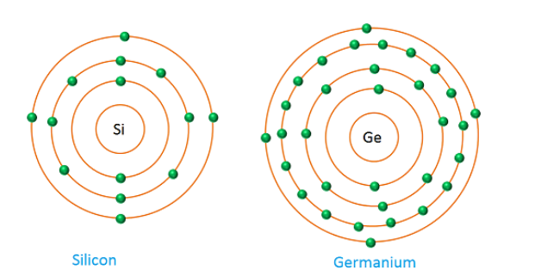
Atomic structure of Semiconductors
Si=2,8,4
Ge= 2,8,18,4

Slide 25
Insulating materials
Electrons are firmly held to their atom
Electron can’t be detached from outermost shell
It is not easy to pass the electric current through them
Ex- bromine, selenium,Arsenic

Slide 26
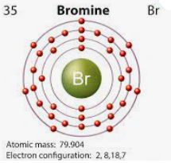
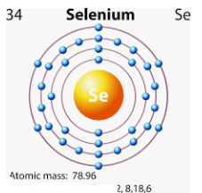
Atomic structure of Insulators

Slide 27
Energy Band Theory
In an atom, electrons revolving in different orbits possess certain energy levels
The amount of energy on each orbit is fixed
In solids, the atoms are closely packed together, So electrons on various orbits are influenced by the energy of electrons of neighbouring orbits
Hence, the electron orbitals overlap when atoms come together.
Energy of various electrons in various bands are considered in a single band.

Slide 28
ENERGY BAND
The range of energies possessed by the electrons of the same orbit of different atoms in a solid
In other words,The electrons in the same orbit exhibit different energy levels. The grouping of these different energy levels is known as the energy band.

Slide 29
Types of Energy Bands
1. Valence Band
2. Conduction Band
3.Forbidden Energy Gap

Slide 30
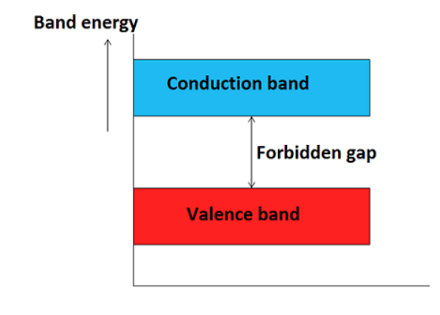

Slide 31
Valence Band
The energy band which is formed by grouping the range of energy levels of the valence electrons or outermost orbit electrons is called as valence band.
It is either completely filled or partially filled
The electrons present in the valence band are loosely bound to the nucleus of atom.
Present below the conduction band

Slide 32
Conduction Band
The energy band which is formed by grouping the range of energy levels of the free electrons is called as conduction band.
Generally, the conduction band is empty but when external energy is applied the electrons in the valence band jumps in to the conduction band and becomes free electrons.
Electrons in the conduction band have higher energy than the electrons in valence band.
The conduction band electrons are not bound to the nucleus of atom.

Slide 33
Forbidden Energy Gap
The energy gap which is present between the valence band and conduction band is called as forbidden band or forbidden gap.
In solids, electrons cannot stay in forbidden gap because there is no allowed energy state in this region.
Forbidden gap is the major factor for determining the electrical conductivity of a solid.
The classification of materials as insulators, conductors and semiconductors is mainly depends on forbidden gap.
The energy associated with forbidden band is called energy gap and it is measured in unit electron volt (eV).

Slide 34
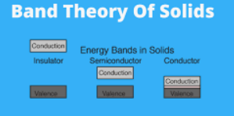
Classfication of materials on the basis of energy band theory

Slide 35
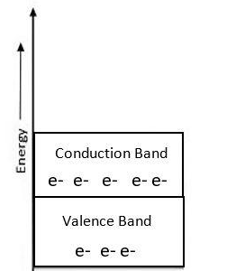
Conductors
There is no forbidden gap between the valence band and conduction band which results in the overlapping of both the bands.
The number of free electrons
available at room temperature is large.
Gold, Aluminium, Silver, Copper

Slide 36
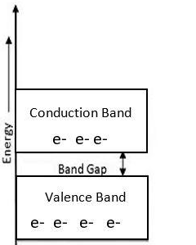
Semiconductors
The conduction band is empty and the valence band is completely filled but the forbidden gap between the two bands is very small that is about 1eV.
For Germanium, the forbidden gap is 0.72eV and for Silicon, it is 1.1eV.
With the application of
small energy, e⁻s can jump
from VB to CB.
Germanium and Silicon

Slide 37
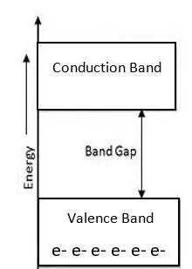
Insulators
The energy gap in the insulator is very high up to 7eV.
The material cannot conduct because the movement of the electrons from the valence band to the conduction band
is not possible.
Glass and wood

Slide 38
Review

