Slide 1
CHAPTER-3

Slide 2
TOPICS TO BE COVERED
Semiconductors and their properties
Materials used for electronic components
Like resistors
Like capacitors
Like diodes
Like transistors
Like inductors

Slide 3
Semiconductor materials
Conductivity lies between conductor and insulator
σ less than conductors but higher than insulators
Ex- Si, Ge, selenium
Medium Resistance and resistivity
10^0 < ϸ < 10^2 Ω-m
Negative ὰ i.e R decreases when T increases
Used in manufacturing of semiconductor devices-diodes, transistors etc

Slide 4
Semi-conducting materials (on the basis of atomic theory)
Elements have 4 valence electrons in the valence orbit
These materials behave as insulators at absolute zero degree temperature
Partial flow of electrons takes place i.e some electrons becomes free, but some electrons are not free
Properties of semiconductors are in between conductors and insulators

Slide 5
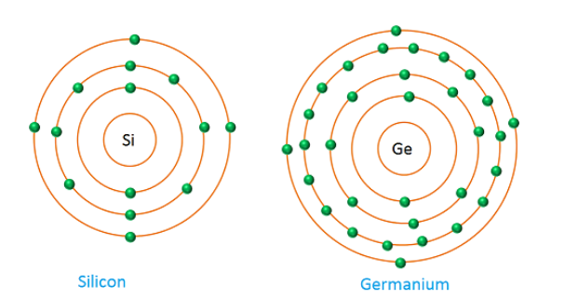
Atomic structure of Semiconductors
Si=2,8,4
Ge= 2,8,18,4

Slide 6
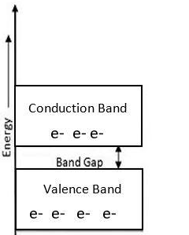
Semi-conducting materials (on the basis of Energy Band Structure)
The conduction band is empty (normally at 0K) and the valence band is partially filled .
The forbidden energy gap between the two bands is very small that is about 1eV.
For Germanium, the forbidden gap is 0.72eV and for Silicon, it is 1.1eV.
With the application of
small energy externally, e⁻s can jump
from VB to CB.
Germanium and Silicon

Slide 7
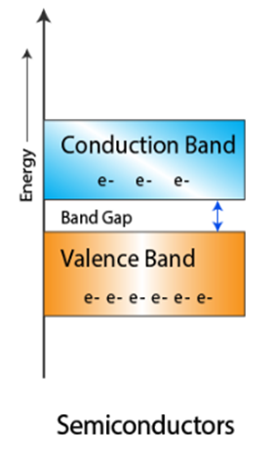

Slide 8
Applications of Semiconductors
l
1. Rectifiers
2. PV cells
3.Transistors
4. Temp sensitive resistors
5. Varistors (non linear Resistors)
6. LCD, LED , TV circuits
7. Memory elements of computer

Slide 9
Crystal Structure of Semiconductors
CRYSTAL : In this , atoms or molecules are arranged in an orderly pattern
All semiconductors have crystalline structure
Each atom is surrounded by neighbouring atoms in a repetitive manner
Large no of atoms are bonded together to give crystal shape
Bonding is because as each atom has the tendency to complete its outermost orbit by gaining 8 e-s. To do so, atom may gain, lose or share valence e-s with neighbouring atom

Slide 10
Crystal Structure of Silicon
Atomic number=14
14 protons + 14 neutrons in nucleus
K=2 ; L= 8; M=4
4 Valence electrons
Each silicon atom shares its four valence electrons with four nearest neighbouring atoms, filling the shell to 8 electrons, and forming a stable, crystalline structure.
This type of bonding by sharing valence electrons are called Covalent bonding

Slide 11
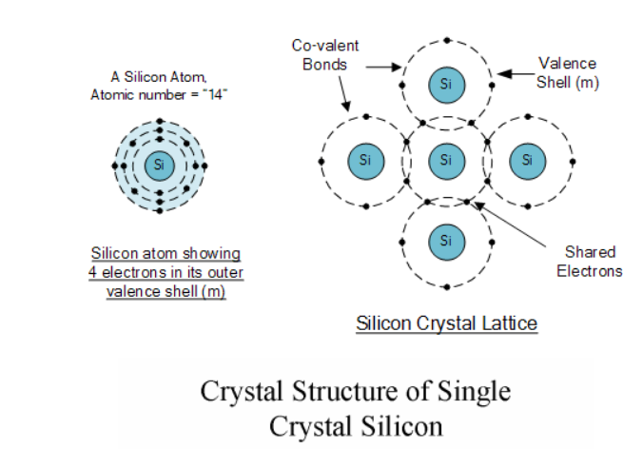

Slide 12
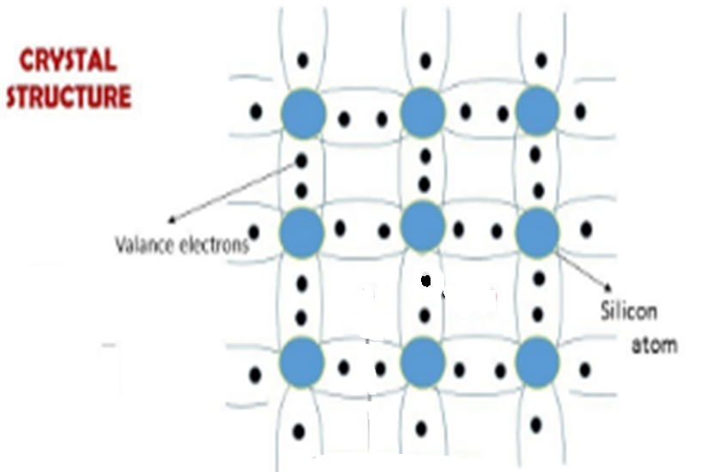

Slide 13
Crystal Structure of Ge
Atomic number=32
32protons + 32 neutrons in nucleus
K=2 ; L= 8; M=18 ; N=4
4 Valence electrons
Each Ge atom shares its four valence electrons with four nearest neighbouring atoms, filling the shell to 8 electrons, and forming a stable, crystalline structure.
This type of bonding by sharing valence electrons are called Covalent bonding

Slide 14
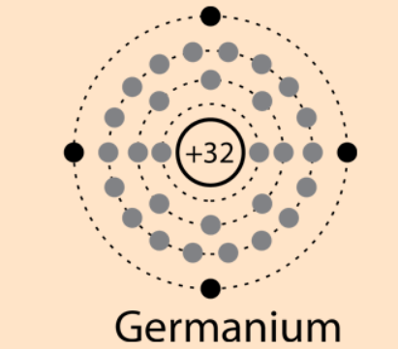
Question for you
Draw the crystal lattice for germanium

Slide 16
Concept

Slide 17
At absolute 0 (0K)
At absolute 0, all e-s are held tightly by atoms, inner e-s are bound to nucleus , valence e-s are bound by covalent bond forces
No free e-s is available in semiconductor, so it behaves like a perfect insulator
VB is completely filled and CB is empty, since there are 4 covalent bonds, each bond is strong, no valence e-s reach CB

Slide 18
Above absolute 0 (0K)
When temperature is increased , some covalent bond breaks due to thermal energy supplied to it, some e-s become free , semiconductor starts conducting
As Heat energy is supplied ,e-s of VB starts jumping to CB which allows conduction
When an electron is jumped to CB , a vacancy is created in VB. This vacancy is called hole

Slide 19
Positively charged Hole
Vacancy of electrons at the specific location of lattice or in VB is called hole
Hole is nothing just a positively charged empty part of semiconductor at some specific location which can’t move
Positive charge on the hole is due to loss of one e- to remain electrically neutral
Hole is very unstable and is quickly filled by the e- from the adjacent covalent bond creating one hole there
So e- and hole moves in opposite direction
No. of holes = no. of electrons for pure semiconductor

Slide 20
ELECTRON HOLE PAIR CONDUCTS??
https://www.youtube.com/watch?v=sWOSPdZHj8o&t=851s

Slide 21
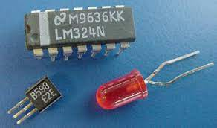
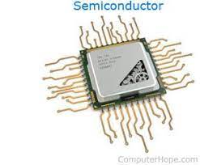
TYPES OF SEMICONDUCTORS

Slide 22
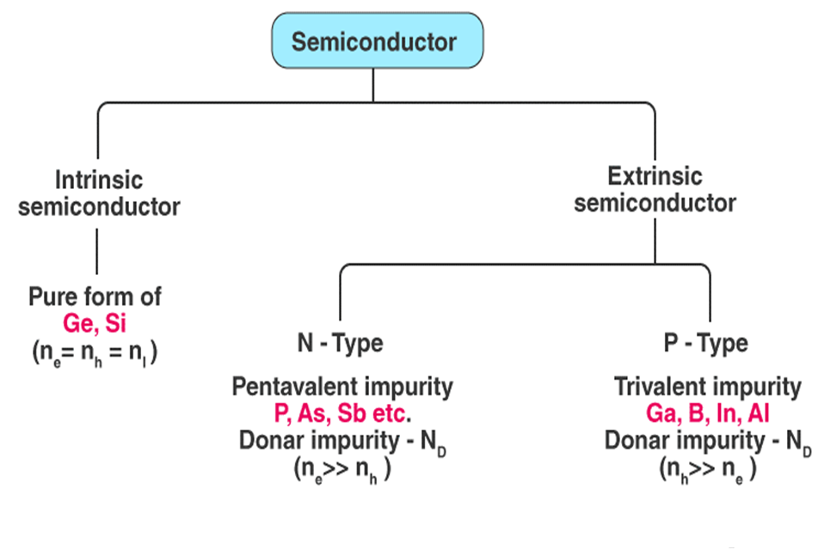

Slide 23
INTRINSIC SEMICONDUCTORS | EXTRINSIC SEMICONDUCTORS
Don’t have any impurities, pure semiconductor | Have added impurities by doping
Conduction takes place by thermally or optically excited e-s | Conduction takes place by free e-s or holes
Conductivity takes place at higher temperature | Conductivity doesn’t depend on temperature. It depend on level of doping
Semiconductor in pure form is not of much use, can only be used as thermistor | These are used in most of the semiconductor devices like diode, transistors, IC s etc

Slide 24
Doping
Doping is the process of adding impurities to intrinsic semiconductors to alter their properties.
Normally Trivalent and Pentavalent elements are used to dope Silicon and Germanium.

Slide 25
S.no | P type SEMICONDUCTORS | N type SEMICONDUCTORS
1 | When intrinsic SC is doped with a trivalent impurity is called P type semiconductor | When intrinsic SC is doped with a pentavalent impurity is called N type semiconductor
2 | Trivalent impurities are Boron, aluminium, indium and gallium | Pentavalent impurities are phosphorus, arsenic ,antimony
3 | Holes are majority charge carriers | Electrons are majority charge carriers
4 | Electrons are minority charge carriers | Holes are minority charge carriers
5 | Hole density is more than electron density | Electron density is more than hole density
6 | Impurity atoms added provide extra holes so called acceptor atoms | Impurity atoms added provide extra electrons so called donor atoms

Slide 26
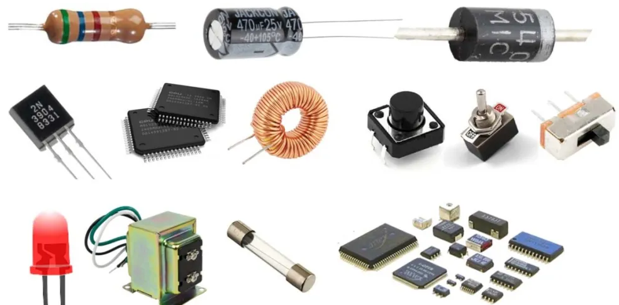
Materials used for electronic components
Resistors
Capacitors
Inductors
Diodes
Transistors

Slide 27
1. RESISTORS
A resistor is a passive component
It offers opposition to the flow of current
These are used in amplifier circuits, voltage division, controlling gain, impedance matching, heat generation etc
These can be classified on the basis of nature, value of R, wattage, material used, specific applications, temperature ratings, cost etc

Slide 28
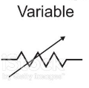
Classification of resistors
Fixed resistors | Variable resistors
Resistance is fixed and can’t be changed | Resistance is not fixed and can be adjusted
Carbon composition resistors, carbon film resistors, metal film resistors, wire wound resistors | Thermistor, voltage dependent resistor (VDR), Light dependent resistor (LDR)
Symbol : | Symbol :

Slide 29
Carbon composition resistors
It consists of fine powder of carbon, a binding resin and insulating filler
Above materials are mixed and then mixture is compressed and fired in an oven
Value of resistance depends on carbon powder
Connections are taken out , copper wire is soldered to it, A metal cap is pressed
Insulation is provided and protection against moisture is done
Low cost
Used in all electronic circuits
Can withstand high voltages, low inductance and capacitance

Slide 30
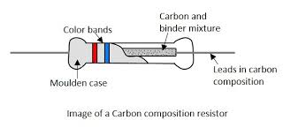

Slide 31
Carbon film resistors
It is made by placing the carbon film or carbon layer on a ceramic substrate.
The carbon film acts as the resistive material to the electric current .
The ceramic substrate acts as the insulating material to the heat or electricity.
These resistors can withstand at higher temperatures without any damage.
Metallic end caps are fitted at both ends of the resistive material. The leads made of copper are joined at two ends of these metallic end caps.
The resistive element of the carbon film resistor is coated with silicon varnish or epoxy for protection from moisture.

Slide 32
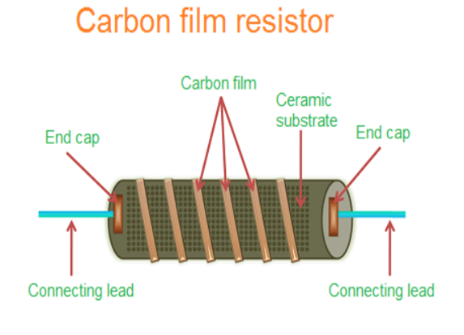
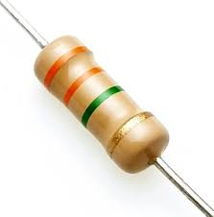

Slide 33
Thermistors
A thermistor is a type of resistor whose resistance is strongly dependent on temperature
The term is a combination of “thermal” and “resistor”.
It is made of metallic oxides, pressed into a bead, disk, or cylindrical shape and then encapsulated with an impermeable material such as epoxy or glass.

Slide 34
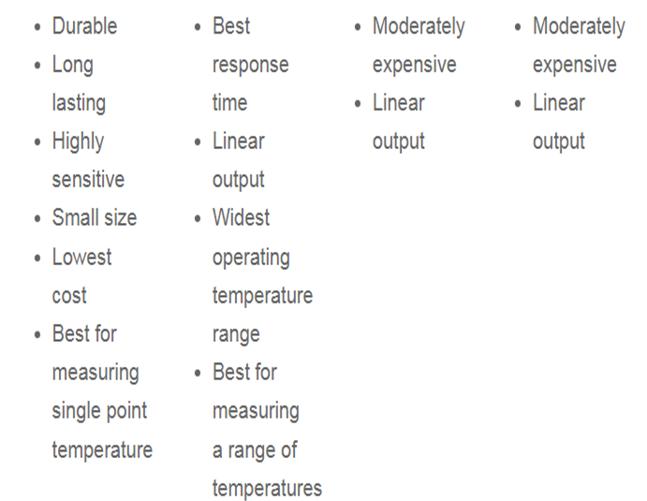
Advantages of Thermistor

Slide 35
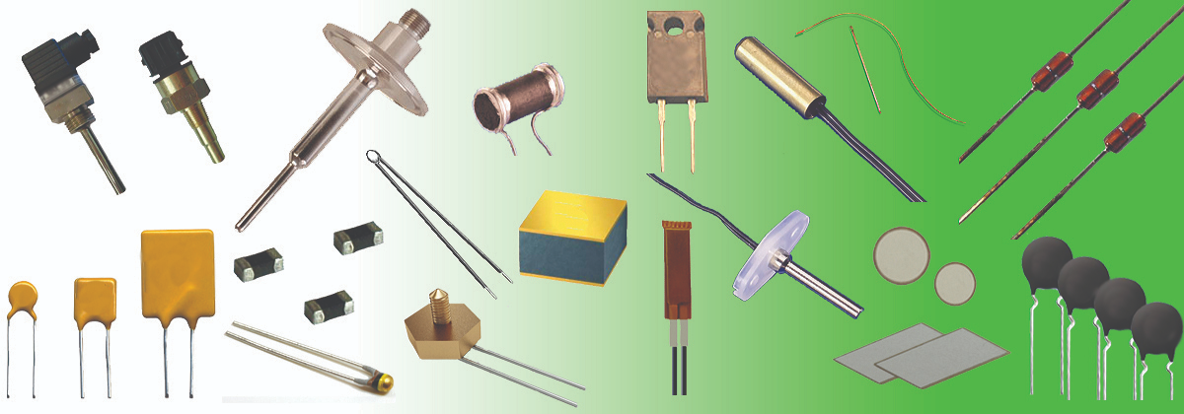
Thermistor images

Slide 36
Applications of thermistors
For accurate temperature measurement as temp sensors
For temperature compensation
Measurement of power at high frequency
Measurement of thermal conductivity
Thermal relays
Temperature actuated control circuits
in every day appliances such as fire alarms, ovens and refrigerators.
digital thermometers
In many automotive applications to measure temperature.

Slide 37
VDR
Voltage dependent resistor
A varistor is an electronic component with an electrical resistance that varies with the applied voltage

Slide 38
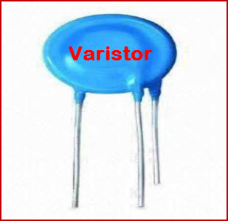
VDR
The word is composed of parts of the words “variable resistor.
Their resistance decreases when the voltage increases.
In case of excessive voltage increases, their resistance drops dramatically.
This behavior makes them suitable to protect circuits during voltage surges. Causes of a surge can include lightning strikes and electrostatic discharges.
The most common type of VDR is the metal oxide varistor or MOV.

Slide 40
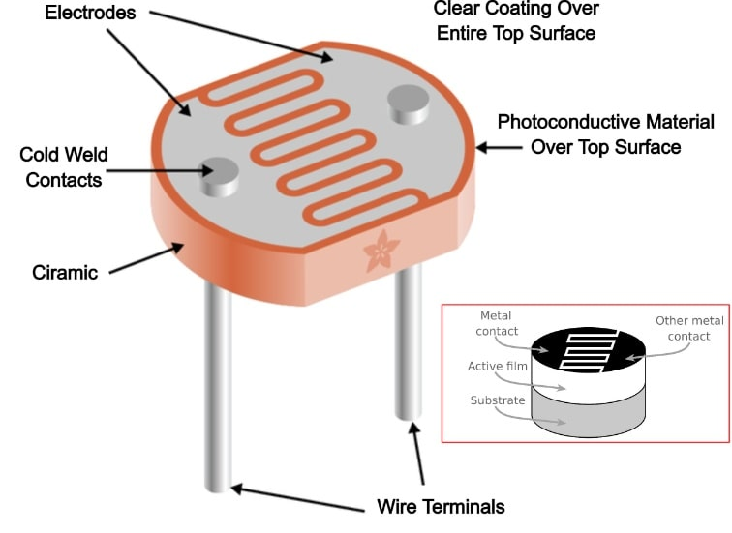

Slide 41
2. CAPACITORS
A capacitor made from two conductive plates with an insulator between them and it stores electrical energy in the form of an electric field.
A capacitor blocks the DC signals and allows the AC signals and also used with a resistor in a timing circuit.
The stored charge is Q=CV
Different types like film, ceramic, electrolytic, and variable capacitors.
Color-coding methods are usedto find the value of C

Slide 42
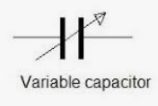
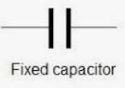
Classification of Capacitors
Fixed Capacitors | Variable Capacitors
Capacitance is fixed and can’t be changed | Capacitance is not fixed and can be adjusted
Mica, ceramic paper | Air gang capacitor
Symbol : | Symbol :

Slide 43
3. INDUCTOR
An inductor is also referred to as an AC resistor which stores electrical energy in the form of magnetic energy.
It resists the changes in the current
Unit of inductance is Henry.

Slide 44
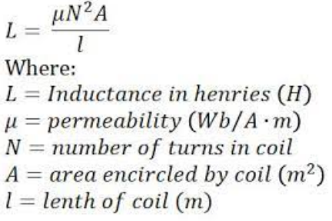

Slide 45
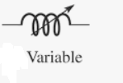
Classification of Inductors
Fixed Inductors | Variable Inductors
Inductance is fixed and can’t be changed | Inductance is not fixed and can be adjusted
RF choke, air core conductor | Iron core inductor
Symbol : | Symbol :

Slide 46
Which one has more inductance?

Slide 47
Which one has more inductance?

Slide 48
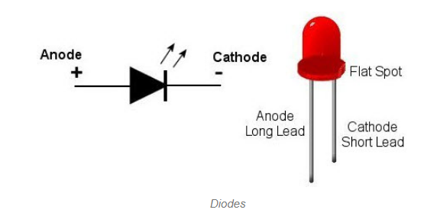
4. DIODE
A diode is a device that allows current to flow in one direction
Usually made with the semiconductor material.
It has two terminals, anode and cathode terminals.
These are mostly used
in converting circuits
like AC to DC circuits.

Slide 49
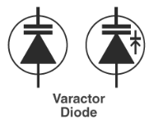
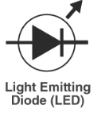
4. DIODE
JUNCTION DIODE | ZENER DIODE | TUNNEL DIODE | VARACTOR DIODE | LED
Used as rectifier | Used as voltage regulator | Used as oscillator | Used as variable capacitor | Emits visible light , used in displays, calculators etc

Slide 50
5. TRANSISTORS
3-terminal semiconductor device.
Used as a switching device and also as an amplifier.
Transistors are of two types,
Bipolar junction transistor (BJT)
Field-effect transistors (FET).
And further, these can be PNP and NPN transistors.

Slide 51
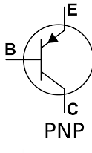
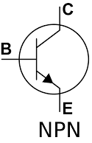
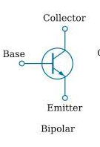
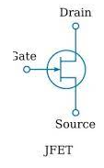
5. TRANSISTORS
BJT | FET | PNP | NPN

