Slide 1
POWER POINT PRESENTATION ON DEFORESTATION
SUBMITTED BY:-
POONAM SHARMA
LECTURER ELECTRICAL

Slide 2


Slide 3
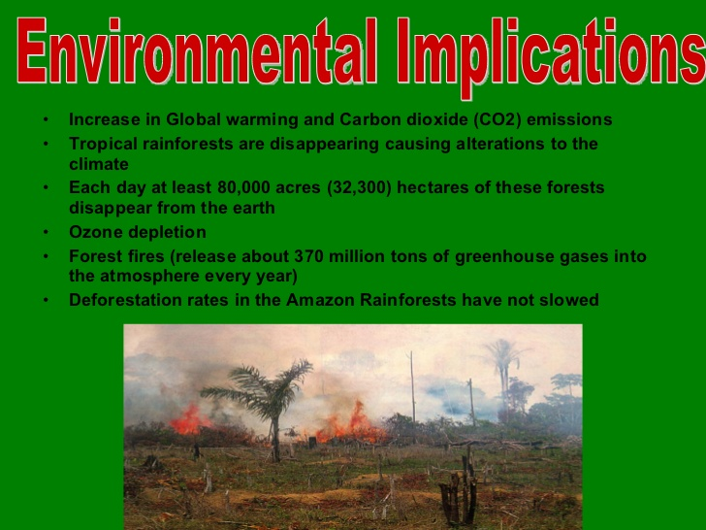

Slide 4
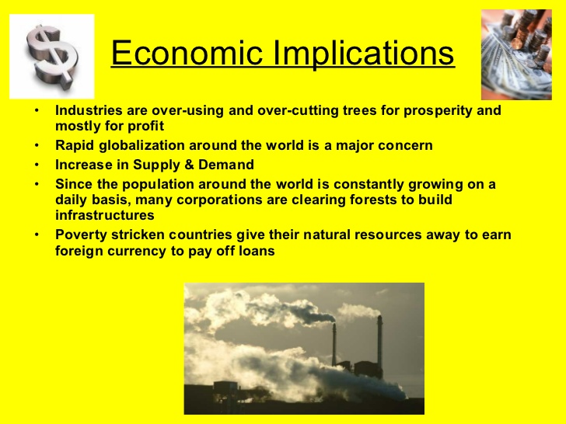

Slide 5
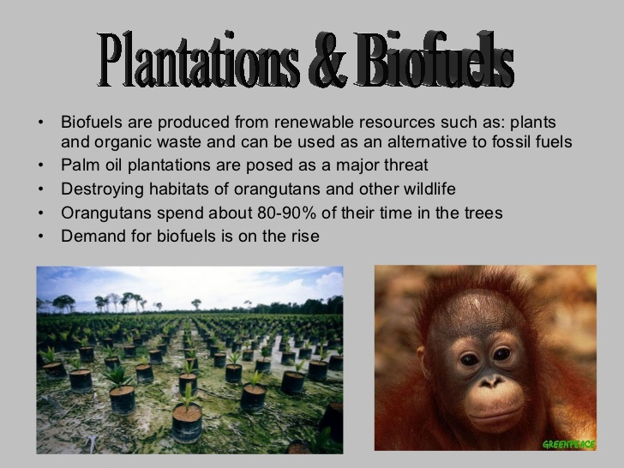

Slide 6


Slide 7


Slide 8
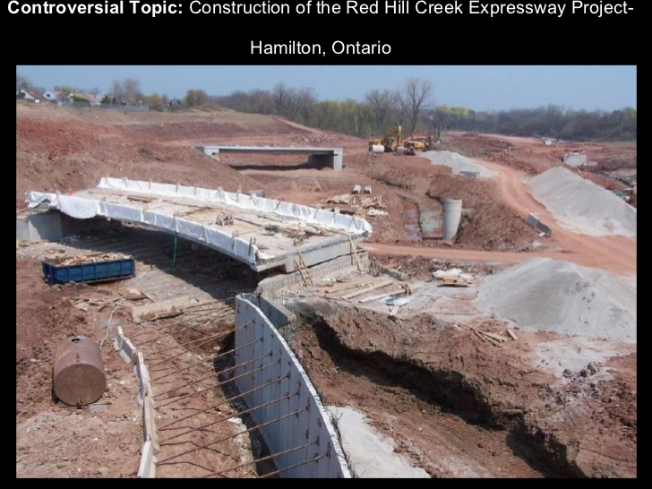

Slide 9


Slide 10


Slide 11
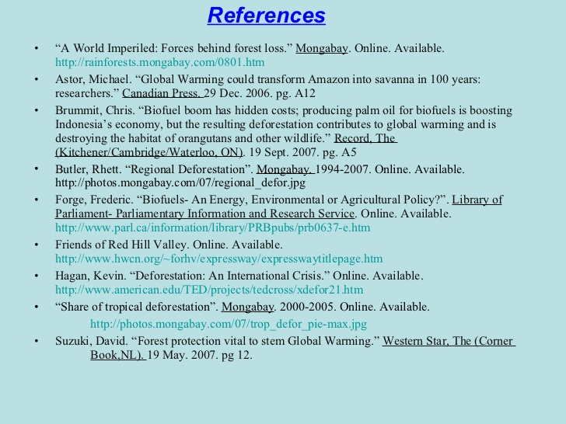

Slide 12
THANK YOU

