Slide 1
OSI REFERENCE LAYERS
Mrs. Meenakshi

Slide 2
CONTENTS
INTRODUCTION
WHAT IS OSI?
OSI MODEL
TYPES OF LAYERS
PHYSICAL LAYER
DATA LINK LAYER
NETWORK LAYER
TRANSPORT LAYER
SESSION LAYER
PRESENTATION LAYER
APPLICATION LAYER
CONCLUSION

Slide 3
What is OSI?
OSI-OPEN SYSTEMS INTERCONNECTION
An open system is a set of protocol that allows any two different systems to communicate regardless of their underlying architectures.
It was designed by ISO-International Organization for Standardization in late1970s.
It is a seven-layer model.
It is a theoretical model designed to show how a protocol stack should be implemented.

Slide 4
OSI MODEL
7
6
5
4
3
2
1
Application layer
Presentation layer
Session layer
Transport layer
Network layer
Data link layer
Physical layer

Slide 5
TYPES OF LAYERS
Physical layer
Data link layer
Network layer
Transport layer
Session layer
Presentation layer
Application layer

Slide 6
PHYSICAL LAYER
The physical layer is responsible for transmitting individual bits from one node to the next
Functions of physical layer:
Physical characteristics of interfaces and media
Representation of bits
Data rate
Synchronization of bits

Slide 7
PHYSICAL LAYER
From data link layer
To data link layer
101010000000101111001
101010000000101111001
Physical layer
Physical layer
Transmission medium

Slide 8
DATA LINK LAYER
The data link layer is responsible for transmitting frames from one node to the next
FUNCTIONS OF DATA LINK LAYER:
Framing
Physical addressing
Flow control
Error control
Access control

Slide 9
DATA LINK LAYER
From network layer
To network layer
frame
T2
frame H2
Data
H2
T2
Data
Data link layer
Data link layer
To physical layer
From physical layer

Slide 10
NETWORK LAYER
The network layer is responsible for the delivery of packets from the original source to the final destination
FUNCTIONS OF NETWORK LAYER:
Logical addressing
Routing

Slide 11
NETWORK LAYER
From transport layer To transport layer
packet H3
packet H3
Data
Data
Network layer
From data link
layer
Network layer
To data link layer

Slide 12
TRANSPORT LAYER
The transport layer is responsible for delivery of a message from one process to another(process-to-process delivery)
FUNCTIONS OF TRANSPORT LAYER:
Port addressing
Segmentation and reassembly
Connection control
Flow control
Error control

Slide 13
TRANSPORT LAYER
From session layer
To session layer
segments
segments
Data H4
Data H4
Data H4
Data H4
Data H4
Data H4
Transport
Transport
layer
layer
To network
layer
From network
layer

Slide 14
SESSION LAYER
The session layer is the network dialog controller. It establishes, maintains,and synchronizes the interaction between communicating systems
FUNCTIONS OF SESSION LAYER:
Dialog control
synchronization

Slide 15
SESSION LAYER
From presentation layer
To presentation layer
L6 data
L6 data
Session layer
Session layer
H5
H5
syn
syn
syn
syn
syn
syn
L5 data
L5 data
To transport layer
From transport layer

Slide 16
PRESENTATION LAYER
The presentation layer is concerned with the syntax and semantics of the information exchanged between two systems
FUNCTONS OF PRESENTATION LAYER:
Translation
Encryption
Compression

Slide 17
PRESENTATION LAYER
From application layer
To application layer
L7 data
L7 data
Presentation layer
Presentation layer
Encoded ,encrypted & compressed data
H6
Decoded ,decrypted & decompressed data
H6
L6 data
L6 data
To session layer
From session layer

Slide 18
APPLICATION LAYER
The application layer enables the user,whether human or software, to access the network. It provides user interfaces and support for services.
FUNCTIONS OF APPLICATION LAYER:
Network virtual terminal
File transfer,access,and management(FTAM)
Mail services
Directory services

Slide 19
APPLICATION LAYER
User
User
Application
Application
layer
X.500 FTAM X.400
layer
X.500 FTAM X.400
L7 data
L7 data
To presentation layer
From presentation layer

Slide 20
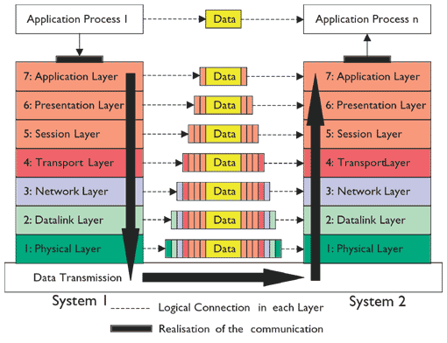
OSI LAYERS MODEL

Slide 21
THANK YOU

